Slide 1

VINTAGE INTELLIGENCE: ASSESSING THE QUALITY OF RED WINE
GROUP 7 | BAN 620
VARSHINI KUPPURAJ (WD1464)
JULIAN ANTOINE HONRADO (HV1231)
MEGH DAVE (CC3118)
KUMAR ABHINAV (SP1411)
VISHWAJIT BHOSALE (KQ3242)

Slide 2


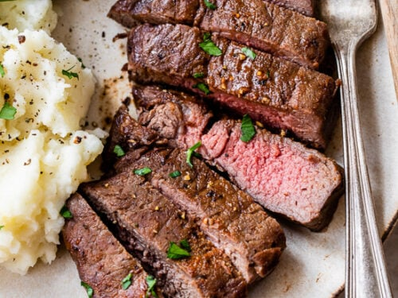
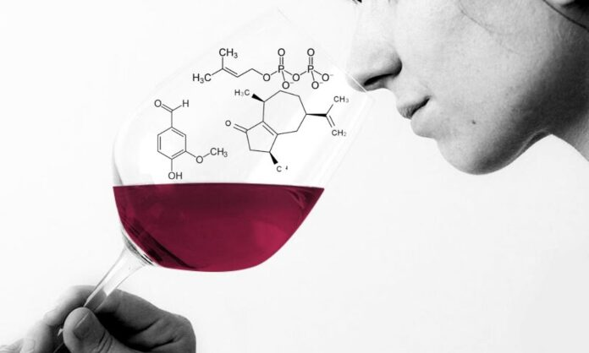
WHY RED WINE?
People have been drinking wine for thousands of years. Why?
Health Benefits
Versatility
Smell
Taste

Slide 3
WHAT MAKES A GOOD RED WINE?
Certain factors such as:
Color
Aroma
Balance
Depth
Complexity
And many other more if you are a wine connoisseur!

Slide 4
WHAT MAKES A GOOD RED WINE?
In a Business Analysts’ perspective
We want to determine how physicochemical properties can affect the quality of wine.
We want to help winemakers, sommeliers and connoisseurs in understanding the key factors that make an impact to the wine’s quality

Slide 5
WINE DATASET
Dataset source: Wine Quality Dataset - Portuguese "Vinho Verde" red wine from UCI Machine Learning Repository
Target outcome variable is Quality with a score of 0 to 10
The dataset contains 1599 rows and 12 columns and is a multivariate dataset.
Variables | Descriptions
Fixed acidity | the non-volatile acids in wine
Volatile acidity | the amount of acetic acid in wine
Citric acid | the amount of citric acid in wine
Residual sugar | the amount of sugar remaining after fermentation.
Chlorides | the amount of salt in wine
Free sulfur dioxide | the amount of sulfur dioxide as a preservative in wine
Total sulfur dioxide | the total amount of sulfur dioxide in wine
Density | the density of wine
pH | the acidity or basicity of wine
Sulphates | the amount of sulfur dioxide bound to potassium in wine
Alcohol | the alcohol content of wine
Quality | the quality rating of wine (scored from 0 to 10)

Slide 6
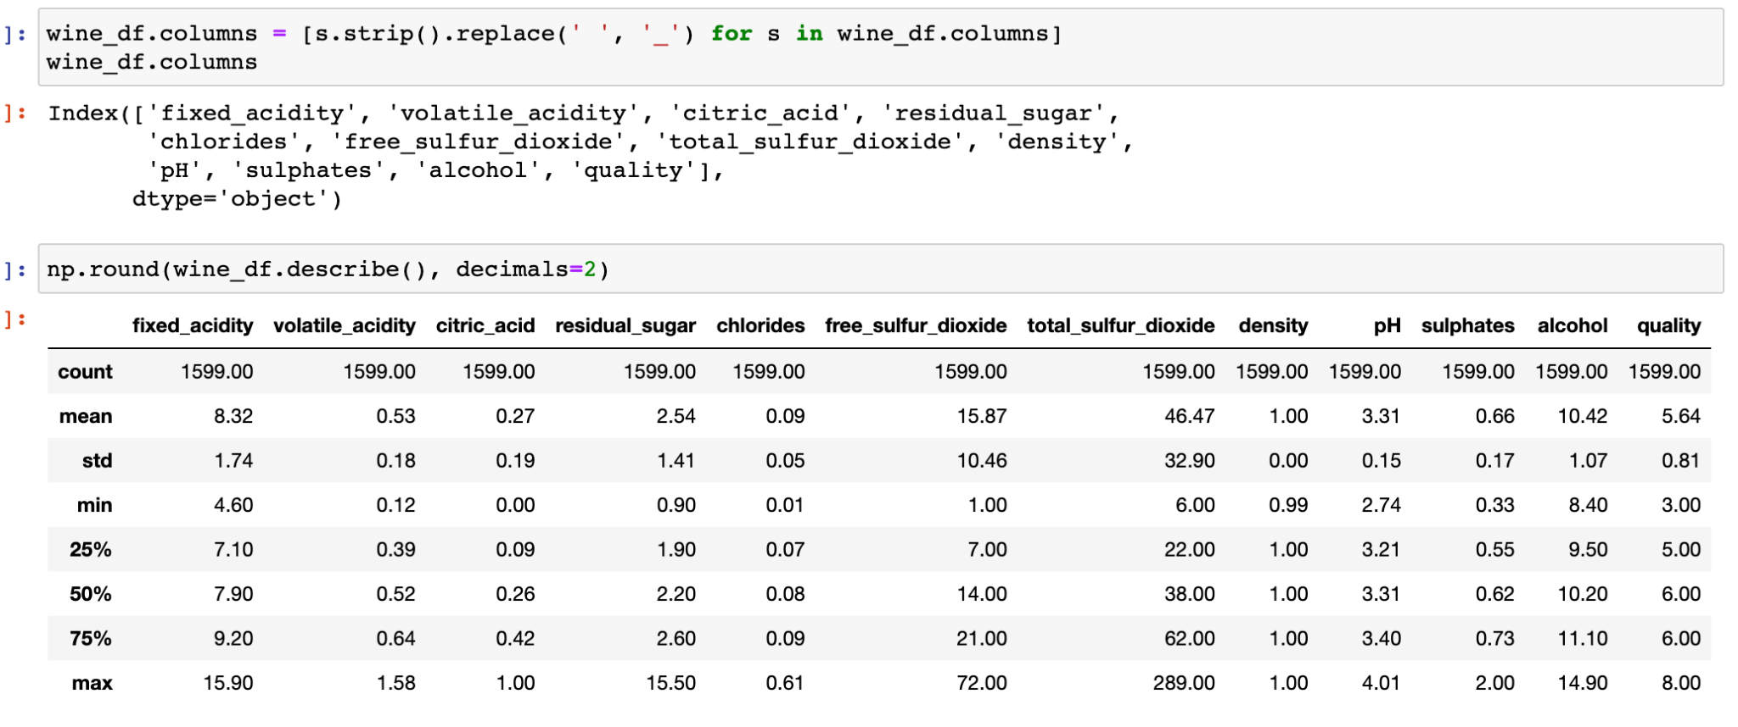
PRE-PROCESSING THE DATA
The data was clean and did not have missing, null or duplicate values.
The data type for all predictors was numeric for ease of analysis.
There are more normal wines in the dataset than excellent or poor wines.

Slide 7
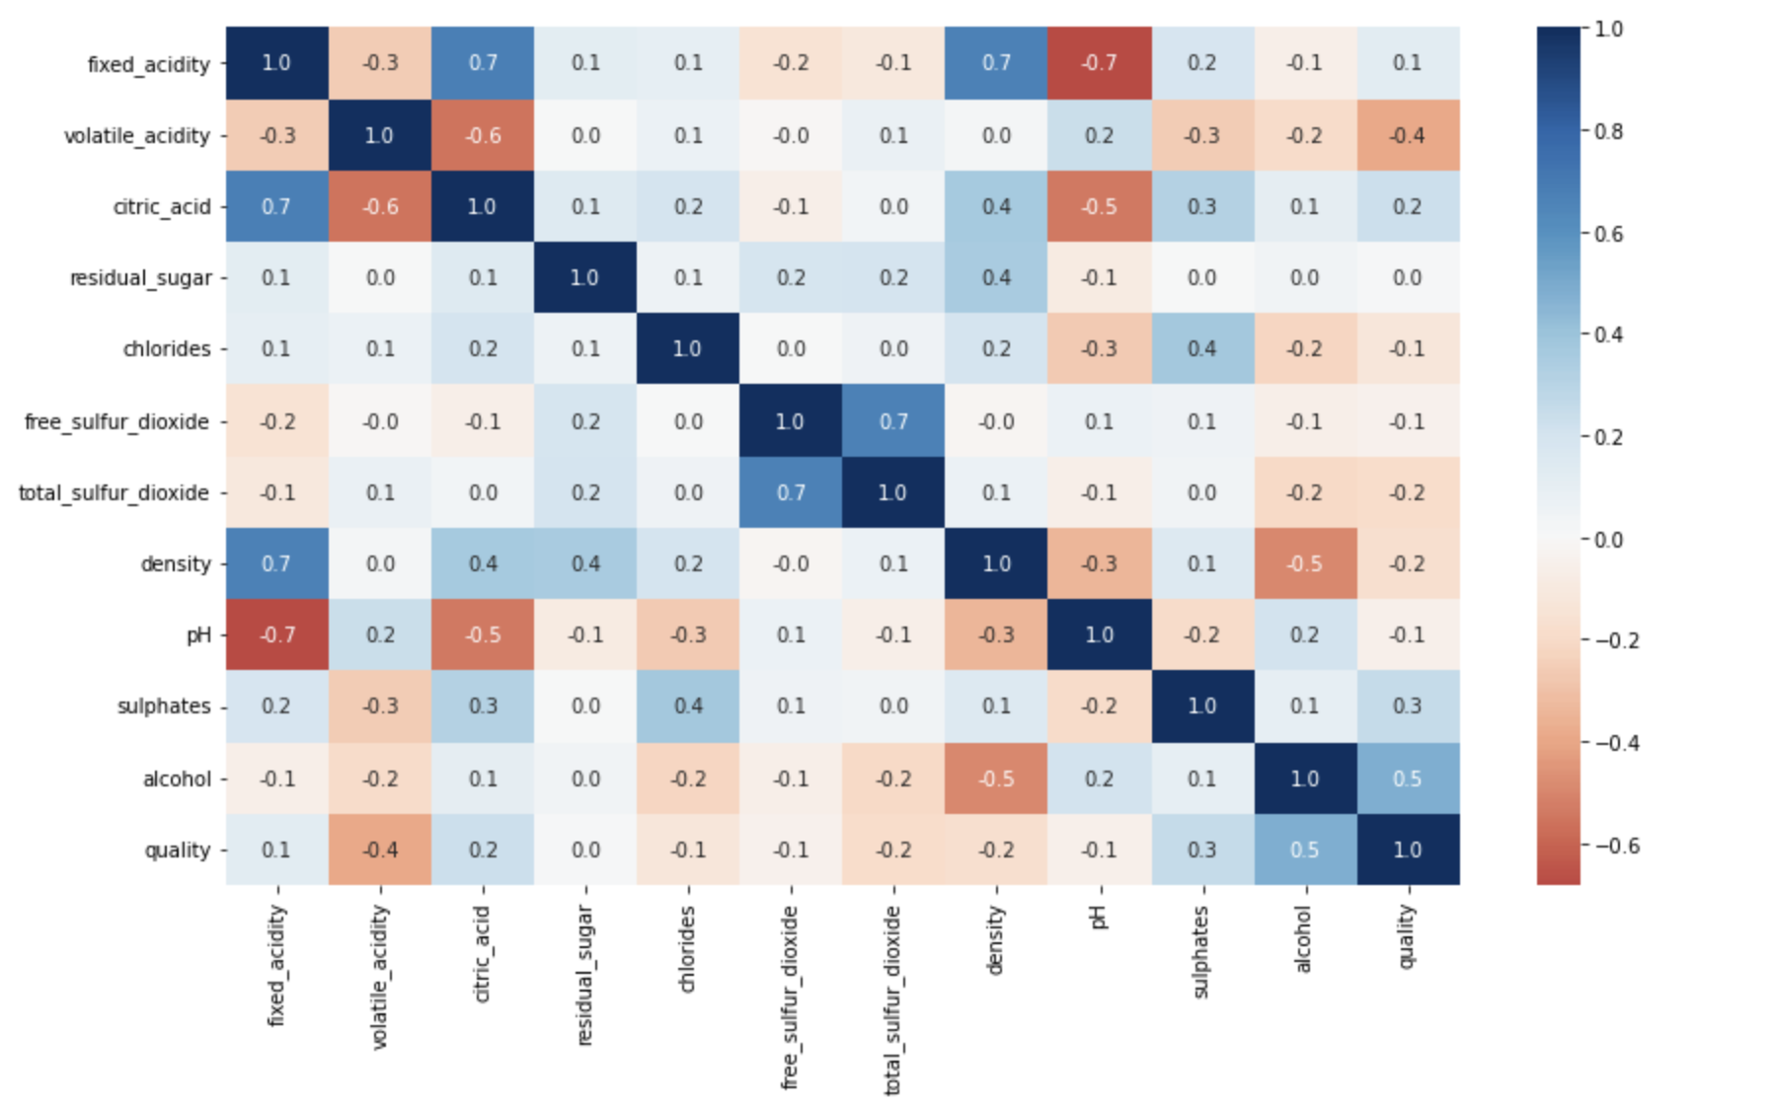
EDA
Normal quality wines have more than 3 times higher total residual sugar than excellent or poor wines.
Normal wines can be of better quality if the total sulphur dioxide content is reduced.
Wines generally have about twice the amount of acetic acid as compared to citric acid.
Notes:
because they appeared to have multicollinearity with ‘total sulphur dioxide’ and ‘fixed acidity’ respectively.
but the average residual sugar content is almost equal, indicating majority of wines in the dataset are of normal quality.

Slide 8
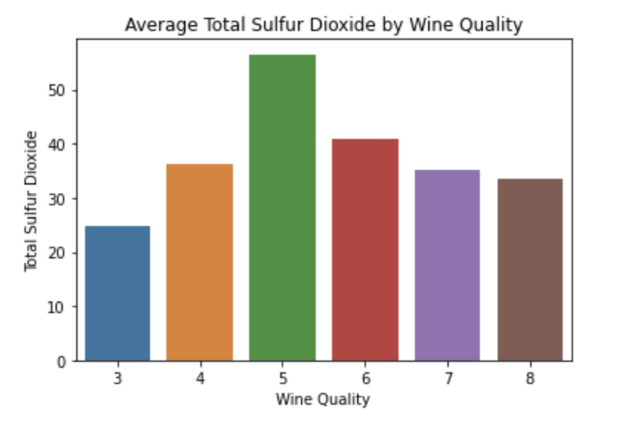
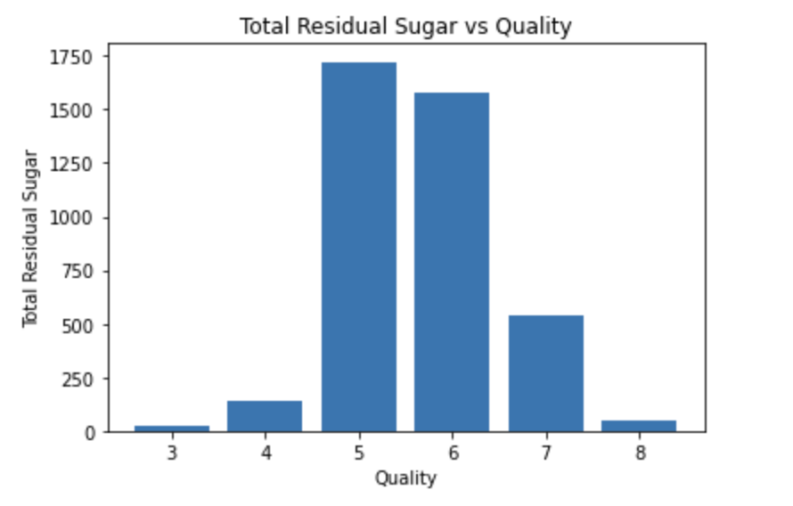
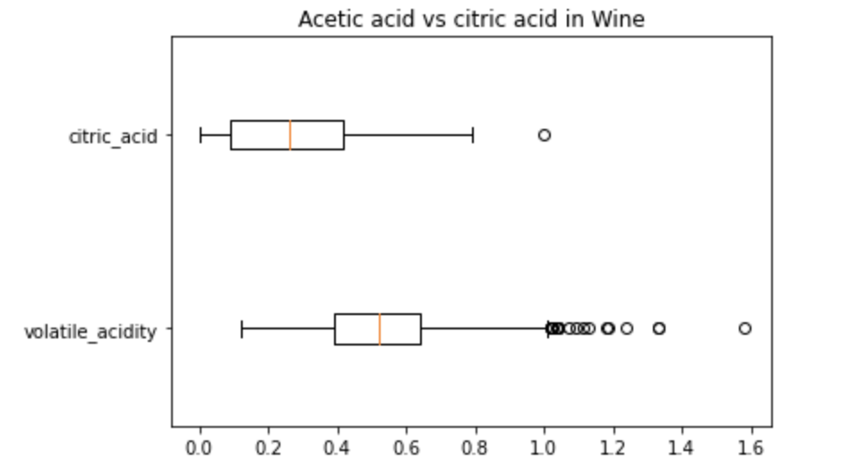
EDA

Slide 9
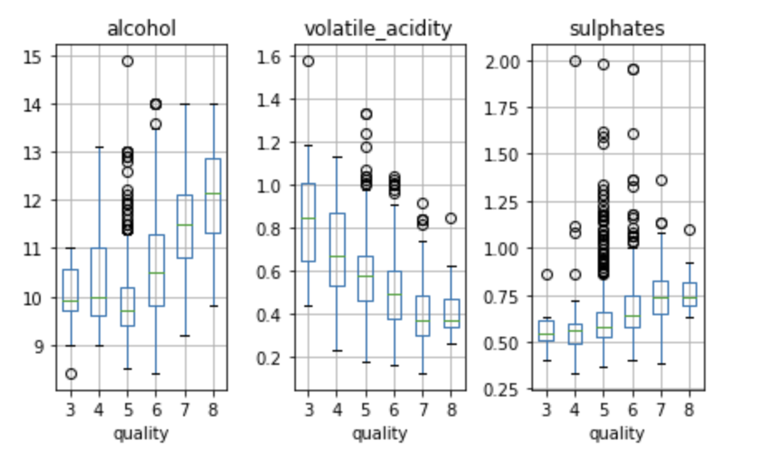
EDA
Alcohol, volatile acidity and sulphates are significantly correlated with the quality of red wine.
Highest quality wines have almost 25% more alcohol content than the lowest quality wines on average.
The acetic acid in the excellent quality wines is more than 50% less than in poor quality wines.
The poor quality red wines have 20% less sulphates than in good quality wines.

Slide 10
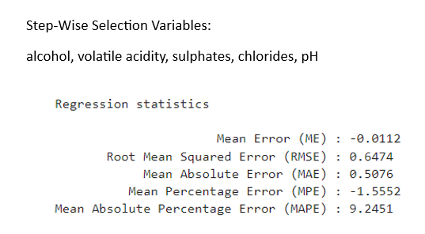
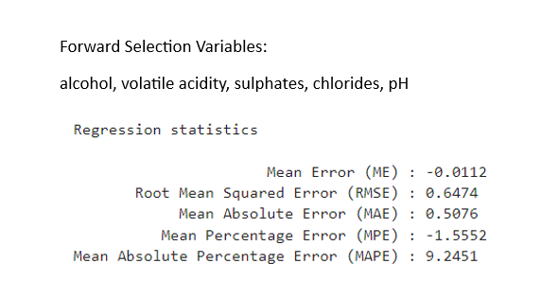
MULTIPLE-LINEAR REGRESSION
The following models regression models that give the better MAPE scores are coming from Step-wise and Forward Selection Methods.

Slide 11
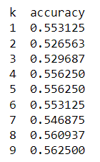
KNN FOR PREDICTION
Default value we took is 5 while building the model.
The best K value we got is 9.
But, KNN shows very low accuracy at about 56% foredtion

Slide 12
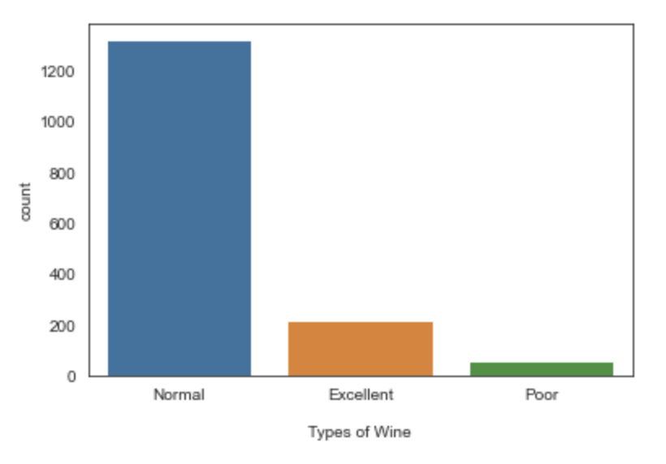
CLASSIFICATION
Multi Class Classification:
Grouping wine quality into 3 Categories,
Poor
Normal
Excellent

Slide 13
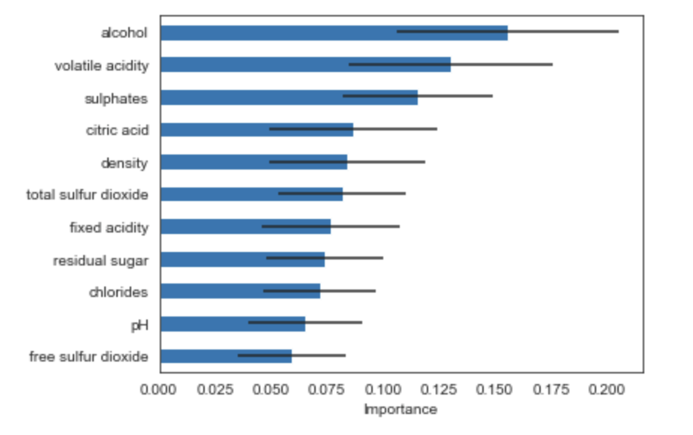
IMPORTANT FEATURES
Using random forest, we indicate which variables are the most important features in the model.

Slide 14
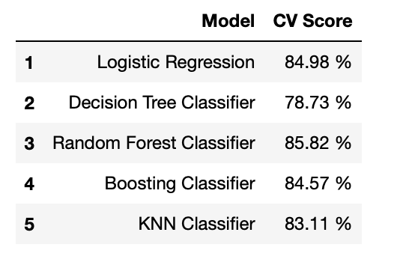
CROSS VALIDATION SCORES (5 FOLD) FOR MULTI-CLASS CLASSIFIER
Interpretation from Classification Report for Random Forest
We were able to classify 50% of poor wine, 88% of normal wines and 67% of excellent wines accurately

Slide 15
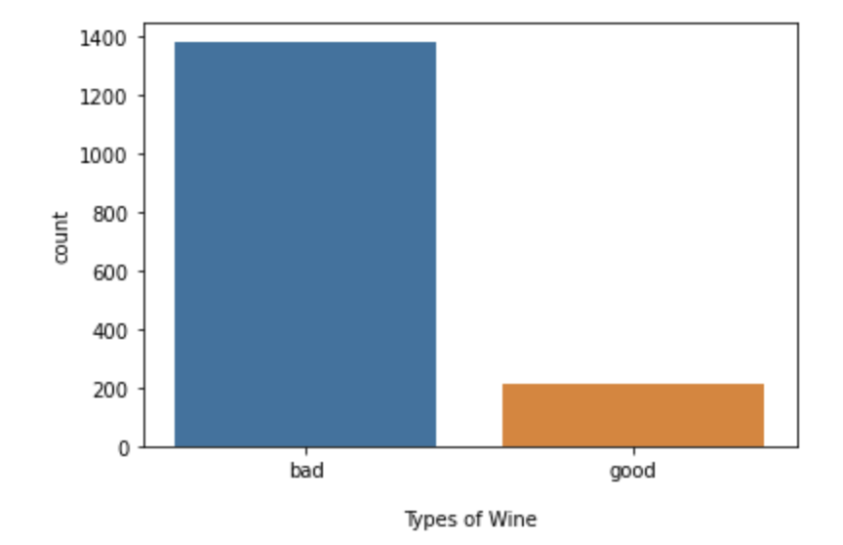
BINARY CLASSIFICATION
Grouping wine quality into 2 Categories,
Good
Bad

Slide 16
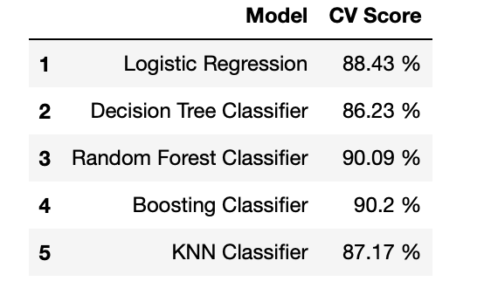
CROSS VALIDATION SCORES (5 FOLD) FOR BINARY CLASSIFIER
Interpretation from Classification Report for Random Forest:
We were able to classify 93% of bad wines and 71% of good wines accurately

Slide 17
RECOMMENDATIONS
We will recommend to look at the following variables: alcohol, volatile acidity, sulphates, chlorides, pH, in predicting the quality of red wines.
However, for classification the important features were alcohol, volatile acidity, sulphates, citric acid and density. These variables played a vital role in classifying into good/bad wines.
Have winemakers look at the total sulfur dioxide levels to maintain the good quality of wines (around 30 to 35ppm).
Since the dataset is not balanced and have majority of the data on the normal quality of wines than the poor and excellent wines, we recommend treating the class imbalance by oversampling.

